Slide 1
.
Qt in Education
Manipulation
de
fichiers
Notes:
The lecture is on widgets and layouts. The idea is to introduce the concepts of widgets and layouts and show how they fit together when creating designs.
Recommended reading before the lecture:
http://doc.trolltech.com/4.6/widgets-and-layouts.html and onwards (follow the link labelled “Next:” at the bottom of each page)

Slide 2

Classes d'accès
Accès direct
  QFile
    Manipulation de flux texte
    Manipulation de flux de données
Accès via une boite de dialogue
  QFileDialog
Notes:
There are many widgets in Qt, and you can add even more.
59+ descendants from QWidget means that there are more than 59 widgets. For instance QAbstractButton inherits QWidget and result in five different buttons (push, radio, check, toolbar and command).

Slide 3
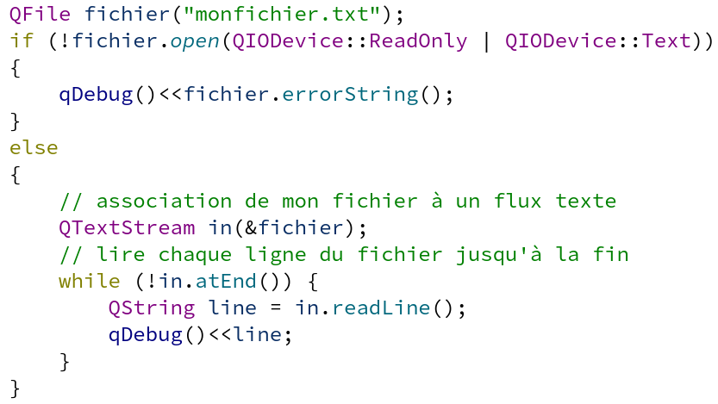
QFile
Lecture d'un flux de type texte ligne par ligne:
Notes:
There are many widgets in Qt, and you can add even more.
59+ descendants from QWidget means that there are more than 59 widgets. For instance QAbstractButton inherits QWidget and result in five different buttons (push, radio, check, toolbar and command).

Slide 4
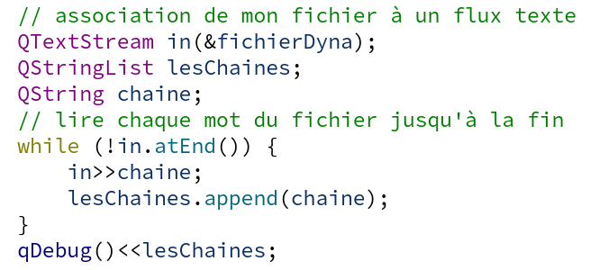
QFile
Lecture d'un flux de type texte mot par mot:
Notes:
There are many widgets in Qt, and you can add even more.
59+ descendants from QWidget means that there are more than 59 widgets. For instance QAbstractButton inherits QWidget and result in five different buttons (push, radio, check, toolbar and command).

Slide 5
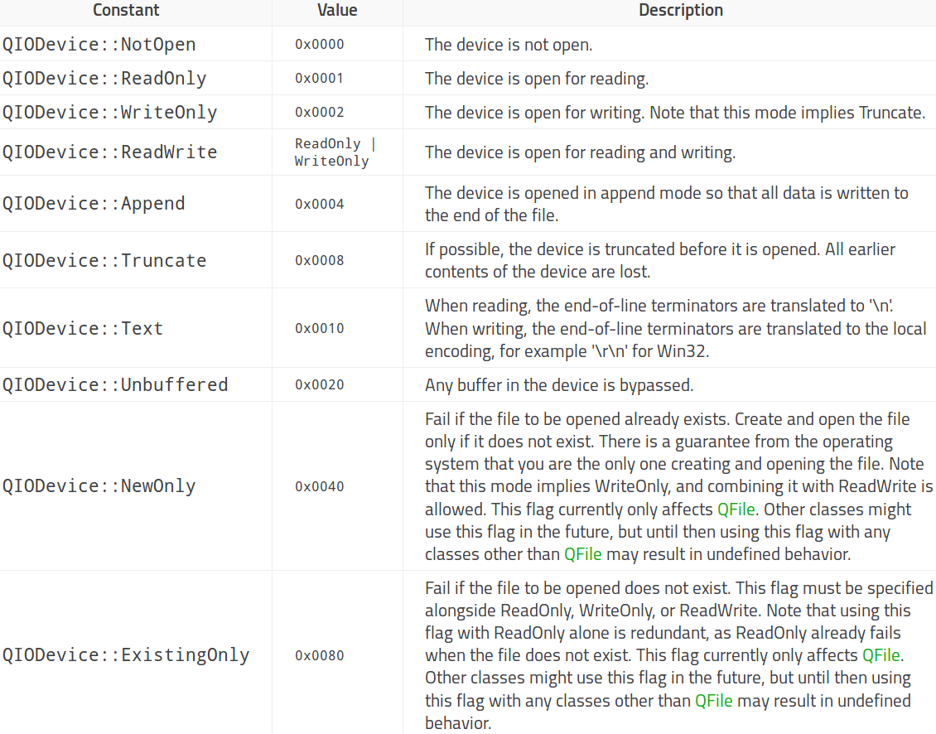
QFile
open les modes d'ouverture possibles
Notes:
There are many widgets in Qt, and you can add even more.
59+ descendants from QWidget means that there are more than 59 widgets. For instance QAbstractButton inherits QWidget and result in five different buttons (push, radio, check, toolbar and command).

Slide 6
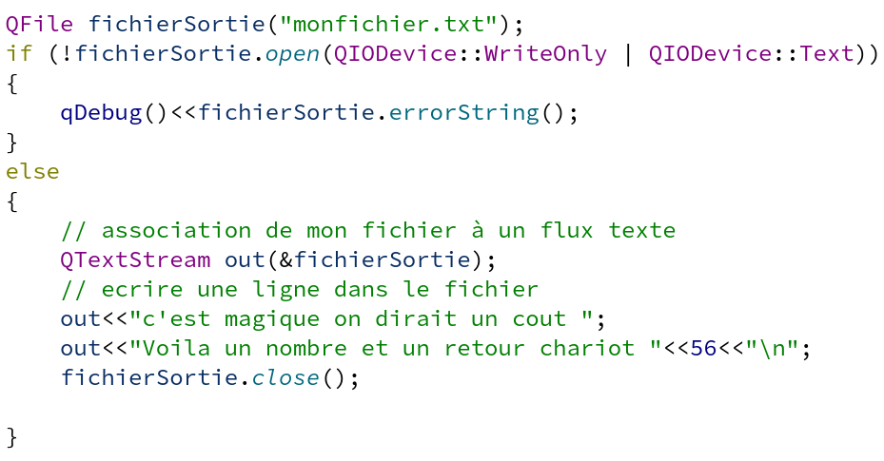
QFile
Ecriture d'un flux de type texte:
Notes:
There are many widgets in Qt, and you can add even more.
59+ descendants from QWidget means that there are more than 59 widgets. For instance QAbstractButton inherits QWidget and result in five different buttons (push, radio, check, toolbar and command).

Slide 7
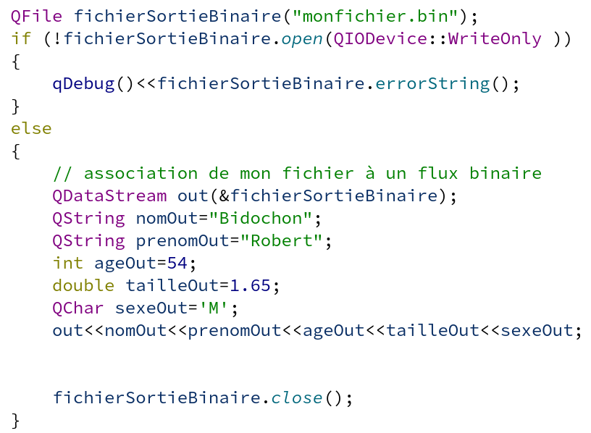
QFile
Ecriture d'un flux de type binaire:
Notes:
There are many widgets in Qt, and you can add even more.
59+ descendants from QWidget means that there are more than 59 widgets. For instance QAbstractButton inherits QWidget and result in five different buttons (push, radio, check, toolbar and command).

Slide 8
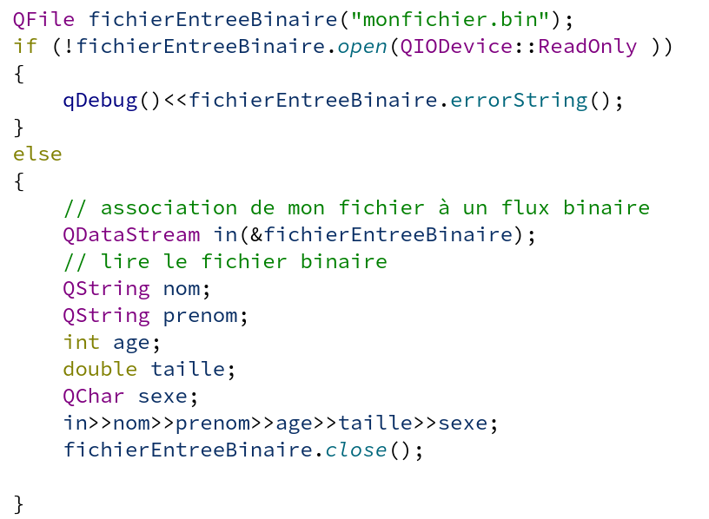
QFile
Lecture d'un flux de type binaire:
Notes:
There are many widgets in Qt, and you can add even more.
59+ descendants from QWidget means that there are more than 59 widgets. For instance QAbstractButton inherits QWidget and result in five different buttons (push, radio, check, toolbar and command).

Slide 9
QFileDialog
Il peut être nécessaire de demander à l'utilisateur de choisir le fichier à traiter.
Pour cela, on peut utiliser les méthodes de la classe QFileDialog.
On utilise, généralement, les méthodes statiques de la classe (pas besoin d'instancier un objet QFileDialog)
Notes:
There are many widgets in Qt, and you can add even more.
59+ descendants from QWidget means that there are more than 59 widgets. For instance QAbstractButton inherits QWidget and result in five different buttons (push, radio, check, toolbar and command).

Slide 10
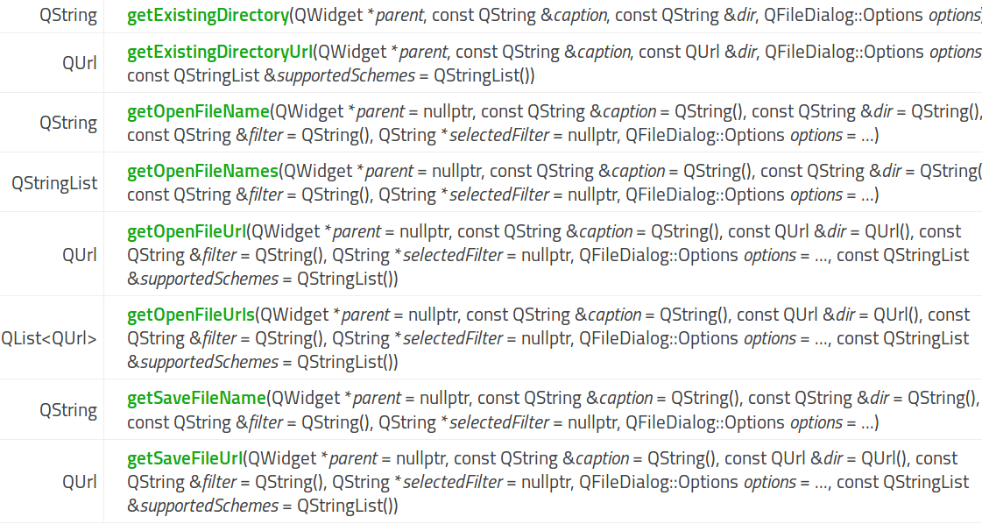
QFileDialog
Méthodes statiques de la classe QFileDialog
Notes:
There are many widgets in Qt, and you can add even more.
59+ descendants from QWidget means that there are more than 59 widgets. For instance QAbstractButton inherits QWidget and result in five different buttons (push, radio, check, toolbar and command).

Slide 11
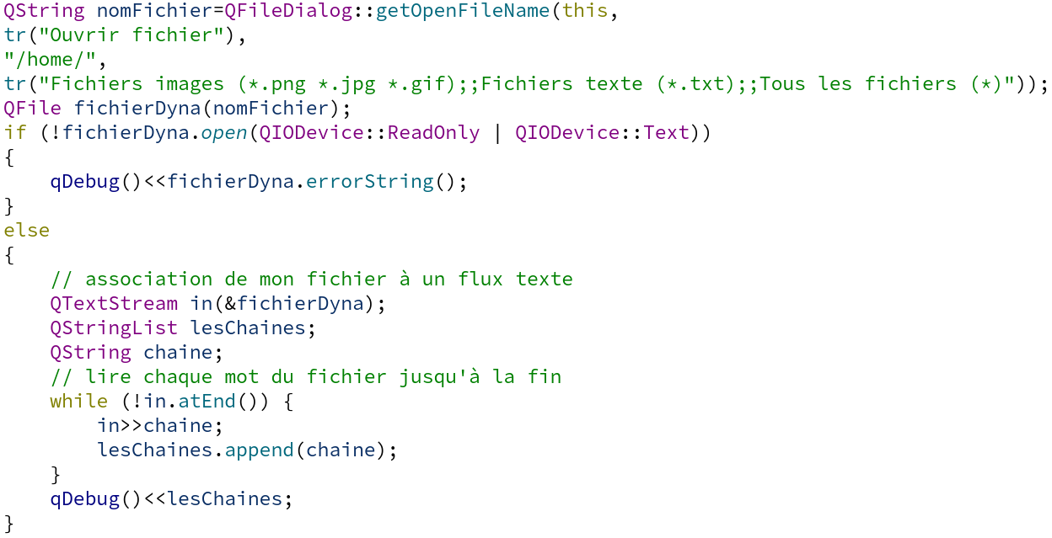
QFileDialog
Exemple pour une ouverture de fichier
1
2
3
1
Titre de la fenêtre
2
Répertoire de départ
3
Intitulé du filtre
( filtres )
;; séparateur
Notes:
There are many widgets in Qt, and you can add even more.
59+ descendants from QWidget means that there are more than 59 widgets. For instance QAbstractButton inherits QWidget and result in five different buttons (push, radio, check, toolbar and command).

Slide 12
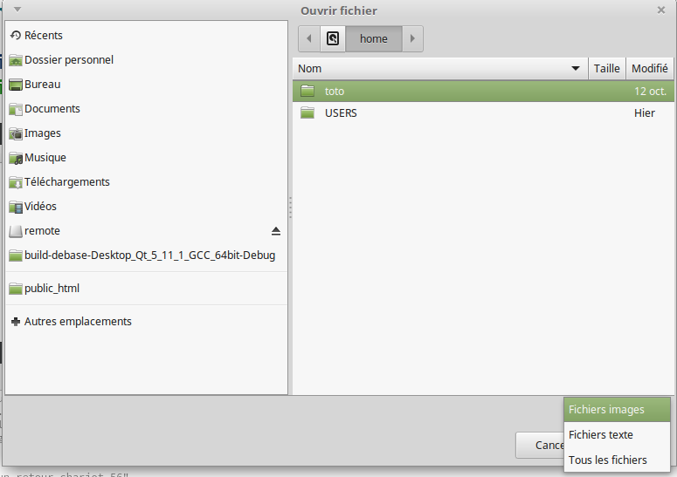
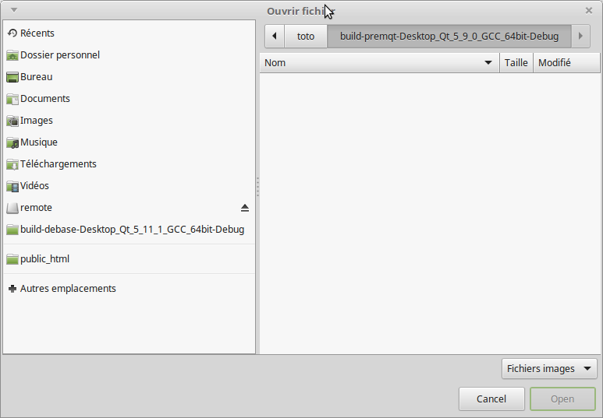
QFileDialog
Exemple pour une ouverture de fichier
Notes:
There are many widgets in Qt, and you can add even more.
59+ descendants from QWidget means that there are more than 59 widgets. For instance QAbstractButton inherits QWidget and result in five different buttons (push, radio, check, toolbar and command).

